Slide 1

This is the Key Stage 2 Mathematics Paper 1: Arithmetic. You will need a pen and something to record your answers on. Write your name and school name on the front of your paper. I will read the instructions to you.
This challenge is to be completed as part of your daily walk/exercise.
You will find a series of questions scattered around your home/ garden/ local area.
There are (15) questions in total.
You must not use a calculator to answer any questions in this test but you can work as a family team.
You have as much time as you need to complete this test. If you cannot do a question, don’t worry, go on to the next one. You can come back to it later if you have time.
If you finish before the end, go back and check your work.
In this test, long division and long multiplication questions are worth 2 marks each. You will be awarded 2 marks for a correct answer. You may get 1 mark for showing a formal method. All other questions are worth 1 mark each.
Remember to check your work carefully.
Remember, I (and others) can help you to answer any of the test questions.
You can talk to each other.
Please send your completed challenge to the school Facebook page so we can see what you’ve been up to! We would love to see pictures of you finding the questions too.
You may now start the test.
Notes:
Notes for teacher: instructions can be posted on your home learning portal or recorded by teacher as a video message and then posted.

Slide 2
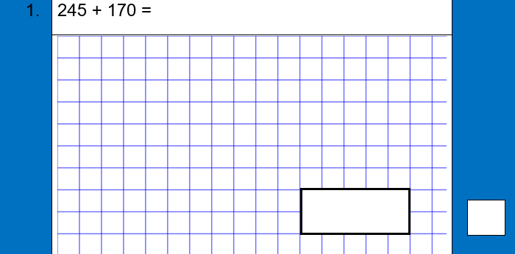
Notes:
Note for teachers: feel free to remove the note at the top if you feel it isn’t needed in your community. Each page is to be printed and laminated and then scattered around the local area for children to find on their daily walk. Alternatively, you can post each question online using your home learning portal.

Slide 3
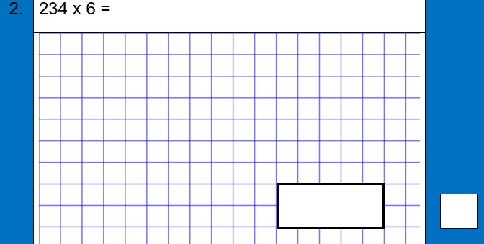
Notes:
Note for teachers: feel free to remove the note at the top if you feel it isn’t needed in your community. Each page is to be printed and laminated and then scattered around the local area for children to find on their daily walk. Alternatively, you can post each question online using your home learning portal.

Slide 4
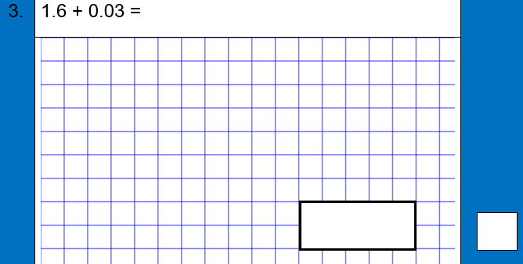
Notes:
Note for teachers: feel free to remove the note at the top if you feel it isn’t needed in your community. Each page is to be printed and laminated and then scattered around the local area for children to find on their daily walk. Alternatively, you can post each question online using your home learning portal.

Slide 5
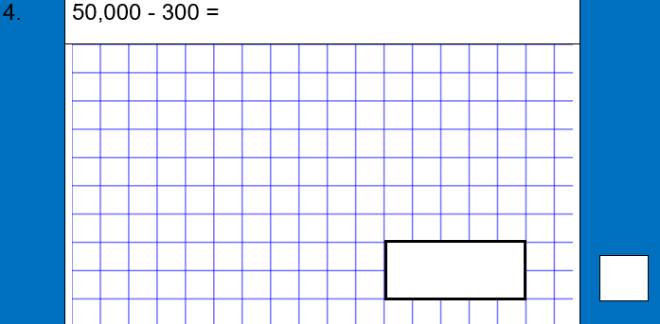
Notes:
Note for teachers: feel free to remove the note at the top if you feel it isn’t needed in your community. Each page is to be printed and laminated and then scattered around the local area for children to find on their daily walk. Alternatively, you can post each question online using your home learning portal.

Slide 6
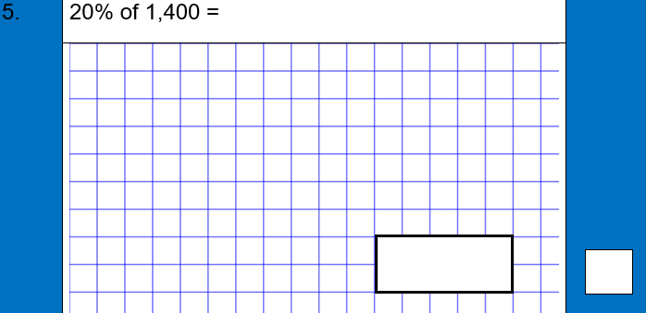
Notes:
Note for teachers: feel free to remove the note at the top if you feel it isn’t needed in your community. Each page is to be printed and laminated and then scattered around the local area for children to find on their daily walk. Alternatively, you can post each question online using your home learning portal.

Slide 7
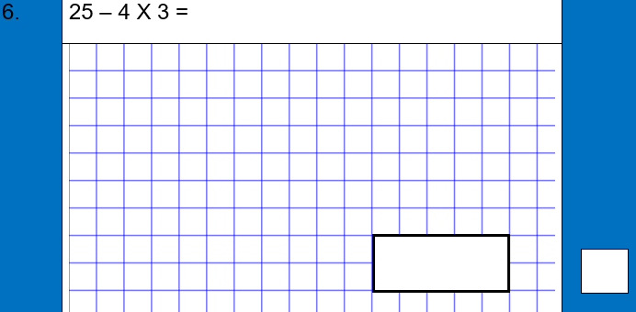
Notes:
Note for teachers: feel free to remove the note at the top if you feel it isn’t needed in your community. Each page is to be printed and laminated and then scattered around the local area for children to find on their daily walk. Alternatively, you can post each question online using your home learning portal.

Slide 8
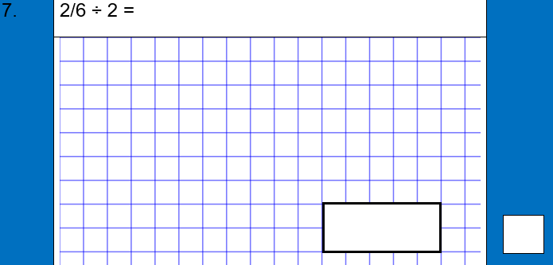
Notes:
Note for teachers: feel free to remove the note at the top if you feel it isn’t needed in your community. Each page is to be printed and laminated and then scattered around the local area for children to find on their daily walk. Alternatively, you can post each question online using your home learning portal.

Slide 9
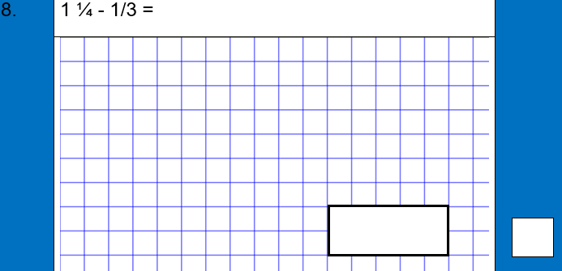
Notes:
Note for teachers: feel free to remove the note at the top if you feel it isn’t needed in your community. Each page is to be printed and laminated and then scattered around the local area for children to find on their daily walk. Alternatively, you can post each question online using your home learning portal.

Slide 10
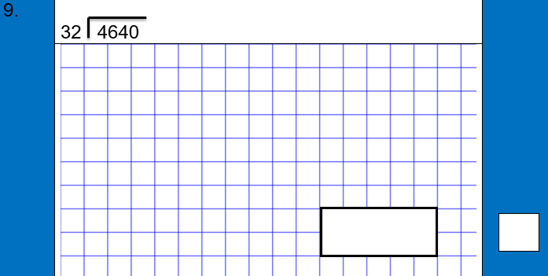
Notes:
Note for teachers: feel free to remove the note at the top if you feel it isn’t needed in your community. Each page is to be printed and laminated and then scattered around the local area for children to find on their daily walk. Alternatively, you can post each question online using your home learning portal.

Slide 11
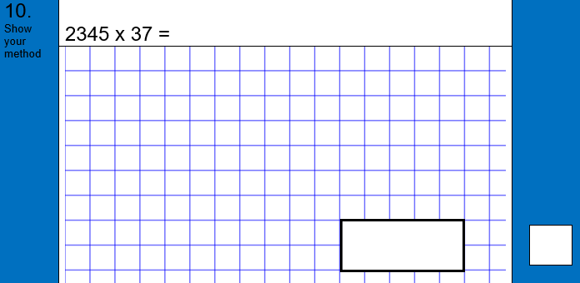
Notes:
Note for teachers: feel free to remove the note at the top if you feel it isn’t needed in your community. Each page is to be printed and laminated and then scattered around the local area for children to find on their daily walk. Alternatively, you can post each question online using your home learning portal.

Slide 12

Notes:
Note for teachers: feel free to remove the note at the top if you feel it isn’t needed in your community. Each page is to be printed and laminated and then scattered around the local area for children to find on their daily walk. Alternatively, you can post each question online using your home learning portal.

Slide 13
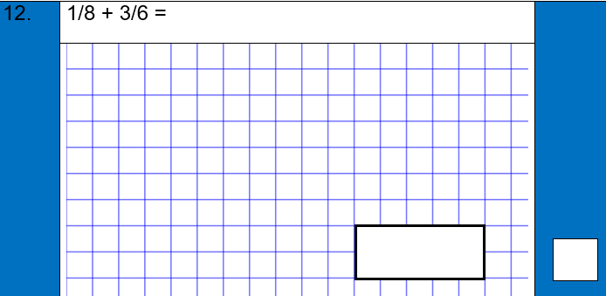
Notes:
Note for teachers: feel free to remove the note at the top if you feel it isn’t needed in your community. Each page is to be printed and laminated and then scattered around the local area for children to find on their daily walk. Alternatively, you can post each question online using your home learning portal.

Slide 14
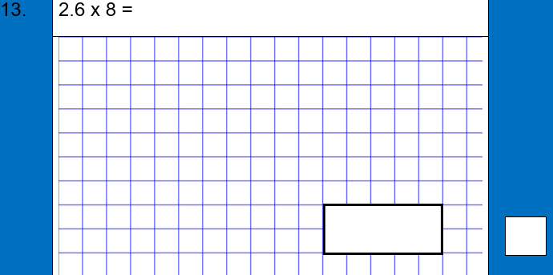
Notes:
Note for teachers: feel free to remove the note at the top if you feel it isn’t needed in your community. Each page is to be printed and laminated and then scattered around the local area for children to find on their daily walk. Alternatively, you can post each question online using your home learning portal.

Slide 15

Notes:
Note for teachers: feel free to remove the note at the top if you feel it isn’t needed in your community. Each page is to be printed and laminated and then scattered around the local area for children to find on their daily walk. Alternatively, you can post each question online using your home learning portal.

Slide 16

Notes:
Note for teachers: feel free to remove the note at the top if you feel it isn’t needed in your community. Each page is to be printed and laminated and then scattered around the local area for children to find on their daily walk. Alternatively, you can post each question online using your home learning portal.

Slide 17
Answers:
Question
1 | 415
2 | 1404
3 | 1.63
4 | 49,700
5 | 280
6 | 13
7 | 2/12, 1/6
8 | 11/12
9 | 145
10 | 86,765
11 | 1308
12 | 15/24
13 | 20.8
14 | 19 ½
15 | 685, 300
Notes:
Notes for teachers: you can provide the clues first or throughout the day as they get stuck on finding certain questions.

