Slide 1
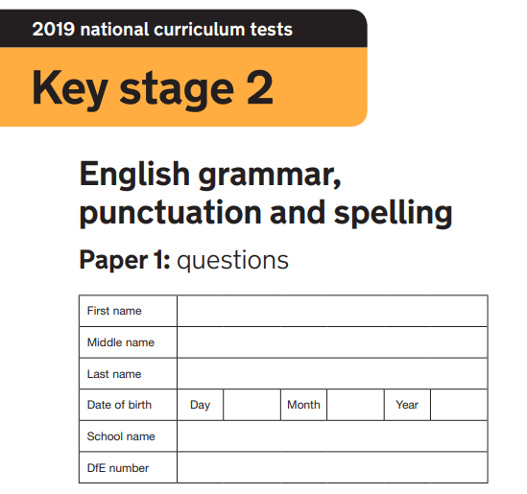
2020
Mark my grammar test for me, please… how did I do?!
Miss Coupe

Slide 2
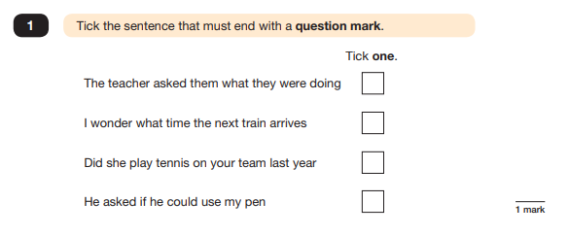

Slide 3
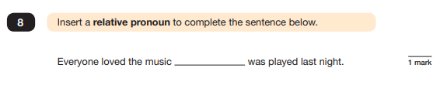
2
what

Slide 4
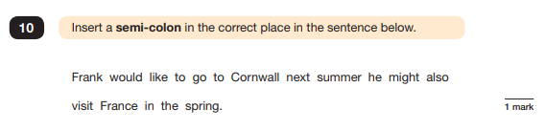
3
:

Slide 5
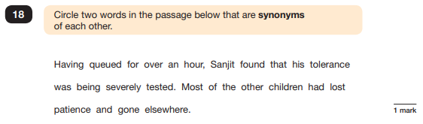
4

Slide 6
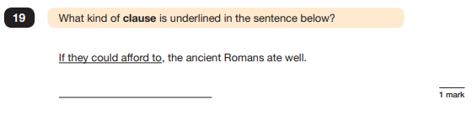
5
Santa Clause

Slide 7
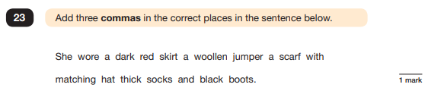
6
,
,
,
,

Slide 8
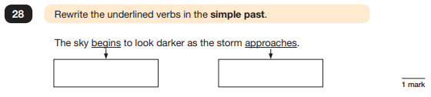
7
Began
aproached

Slide 9
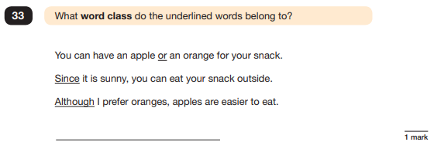
8
Mountains class

Slide 10
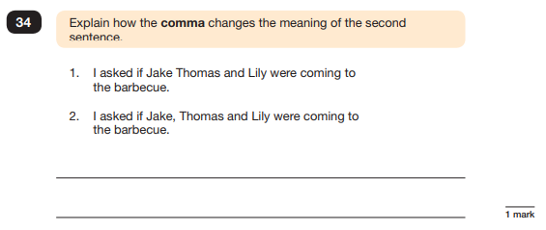
9
You breathe where the comma is so in the second one the speaker is obviously out of breath

Slide 11
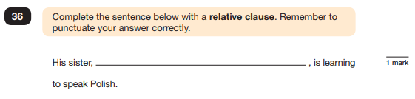
10
a relative clause

Slide 12
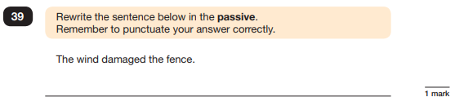
11
the fence was damaged by the wind.

Slide 13
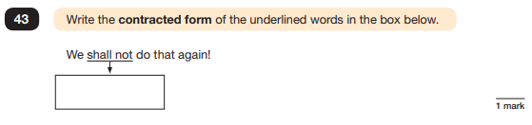
12
shall’ot

