Slide 1
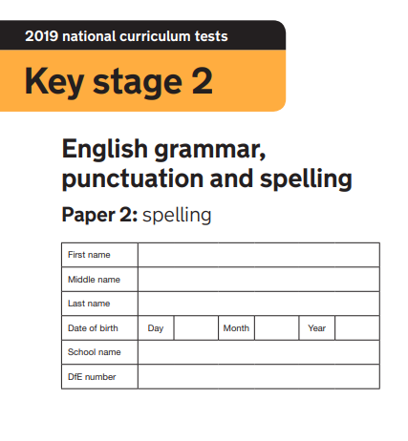
2020
Made by @mrbrownteach

Slide 2

Corey and Ashton bought a __________ for their mum
Kylan wanted to be a __________
For lunch, Aimee and Emmie ate a __________
Ruby’s party was a really good __________!
The shop accepted Harry’s __________ as payment
Philip went fishing and caught a __________
Jak and Connor loved to play __________
Kacy and Lydia chased the car with a __________ in hand
Melody’s gloves were made with natural __________
Alex shouted __________ Harry stole his shorts

Slide 3
Katie __________ her homework
To be a real __________, Evie had to work hard
Ruby ate her __________ with Riley and Jack at break
Declan had __________ brothers and one sister
Luke bought a new dog for his brother; it was a __________
Maddy hit Georgia and Lacey __________ they all cried
Gracie told Millie to __________
Jess had not seen her __________ for 3 years
Layla’s clock would not __________
Miss Coupe’s and Mrs Matthews’s classes are __________

