Slide 1
MODERN WONDERS OF THE WORLD
VIRTUAL SCHOOL TRIP

Slide 2
Welcome to your virtual tour of the Modern Seven Wonders of the World!
We invite you to learn a little bit more about each of the Modern Wonders of the World and use the website links provided to take a tour of each Wonder. When you have finished touring we have included a grid of learning challenges. We suggest you complete 2 of the challenges each day. Remember to keep sending us your work!

Slide 3
HOW THE WEEK WILL WORK...
On Monday - take some time to explore all the different links and find out whatever you want about the different Wonders of the World.
Every day after that - choose at least 2 challenges from the grid to complete. There are resources included below to help you with your challenges. Remember to send us your learning as usual.
We hope you enjoy your VIRTUAL SCHOOL TRIP!

Slide 4
What are the Modern Wonders of the World
The original list of Wonders of the World was written in the second century BC. Many of the original monument didn’t exist any more (the only original Wonder which still exists are the Pyramids in Egypt) - so a Swiss organisation carried out a world-wide vote in 2000BC to update the Wonders of the World. After millions of votes, they came up with a list of 7 of the most impressive and important monuments around the world! This is your chance to visit them!!

Slide 5
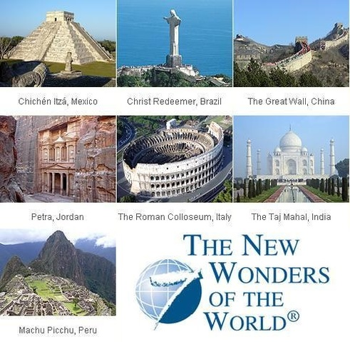

Slide 6
Links to the tours...
GREAT WALL OF CHINA TOURS
https://www.thechinaguide.com/destination/great-wall-of-china
http://www.airpano.com/360photo/China-Great-Wall/
MACHU PICCHU (PERU) TOUR
https://www.youvisit.com/tour/machupicchu
TAJ MAHAL (INDIA) TOUR
https://www.google.com/maps/@27.1737154,78.0420194,3a,75y,9.12h,89.93t/data=!3m6!1e1!3m4!1sz1J2kgnS2xmJQTOPTcHIVg!2e0!7i13312!8i6656?hl=en%2F%2Fwww.google.com%2Fmaps%2Fpreview%2F%4027.173385%2C78.042122%2C3a%2C75y%2C1.38h%2C89.29t%2Fdata%3D%213m5%211e1%213m3%211sypwvZafR9EHGbeK0JPItLg%212e0%213e5%3Fhl%3Den
https://www.airpano.com/360photo/Taj-Mahal-India/

Slide 7
Links to the tours...
PETRA (JORDAN) TOURS
http://visitpetra.jo/Pages/viewpage.aspx?pageID=140
https://www.google.co.uk/maps/about/behind-the-scenes/streetview/treks/petra/
https://secretldn.com/eurostar-passport-free-travel/
PYRAMIDS OF GIZA (EGYPT) TOUR
http://www.3dmekanlar.com/en/the-pyramids.html
THE COLOSSEUM (ITALY) TOUR
https://www.il-colosseo.it/en/visita_virtuale_colosseo.php
https://www.touristtube.com/Things-to-do-in-Rome/Colosseum-360
CHRIST THE REDEEMER STATUE (BRAZIL) TOUR
https://www.airpano.com/360photo/Christ-the-Redeemer/
http://www.worldtour360.com/360.php?country=Brazil&swf=ChristtheRedeemer20091227&lang=en
https://www.youvisit.com/tour/brazil

Slide 8
ENGLISH | MATHS | ART/DT | SCIENCE / THEME
Create a travel brochure to advertise why people should come and visit the modern wonders of the world. Include things to see and do, what the cultures are like, food you might sample. | Using the map provided - calculate a route which would visit all of the seven wonders of the world. What is the shortest possible route? What is the longest possible route? | Sketch three of the seven wonders of the world - you choose which ones. | Write like the Mayans. Use the Mayan Alphabet to create a short message explaining why people should visit Chichen Itza.
Film a short video diary of yourself talking about your favourite wonder! What did you see, how did it make you feel, what could you hear/smell/touch? | Complete the Exchange Rate challenge to see how much money you would need to visit each of the different Wonders of the World. | Make a 3D model of one of the Seven Wonders - you could use card, lego, play-doh, cushions etc. etc. Send us a photo of your creation. | Research the date which all of the Seven Wonders were created (or thought to have been created). Place these in order on a timeline - from longest ago to the present day.
Create a poem about one of the wonders you have seen. Can you use repetition, alliteration, similes and rhyme? | There are lots of pyramids in the New Seven wornder of the world. See if you can solve the number pyramid problems. | Create an edible creation which looks like one of the Seven Wonders. | Research the languages spoken in each country of the Seven Wonders. Can you pick 5 phrases you have learnt in the different languages?

Slide 9
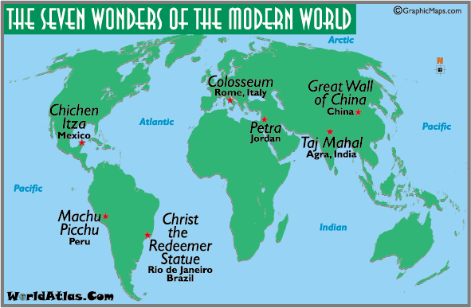
8093km
9,349km
3650km
3800km
4138km
10571km
4150km
10262km
3275km

Slide 10
Exchange rate challenge.
How much would the following items cost if you had to convert from pounds to the local currency (money)
Exchange rates:
PYRAMID OF GIZA: Great British Pound (GBP) - Egyptian Pound (1 GBP = 20 Egyptian Pounds)
COLOSSEUM: Great British Pound (GBP) - Italian Euro (1 GBP = 1.5 Italian Euros)
MACHU PICCHU: Great British Pound (GBP) - Peruvial Sol (1 GBP = 5 Peruvian Sol)
TAJ MAHAL: Great British Pound (GBP) - Indian Rupee (1 GBP = 20 Indian Rupee)
GREAT WALL OF CHINA: Great British Pound - Chinese Yuan (1 GBP = 8 Chinese Yuan)

Slide 11
 | Entrance Ticket (cost = £10 GBP) | Sightseeing guide (Cost = £8 GBP) | Souvenir (Cost = £7.50 GBP) | Food and Drink (Cost = £12.50 GBP)
PYRAMID OF GIZA 1GBP = 20 Egyptian pounds
COLOSSEUM 1GBP = 1.5 Italian Euros
MACHU PICCHU 1GBP = 5 Peruvian Sol
TAJ MAHAL 1GBP = 100 Indian Rupees
GREAT WALL OF CHINA 1GBP = 8 Chinese Yuan

Slide 12
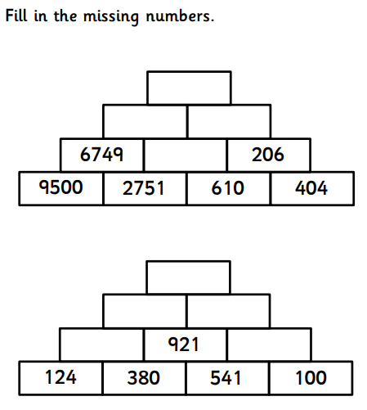
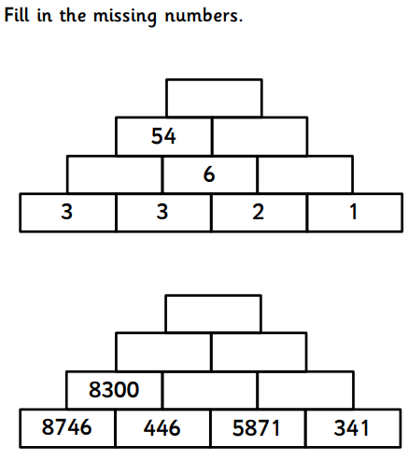
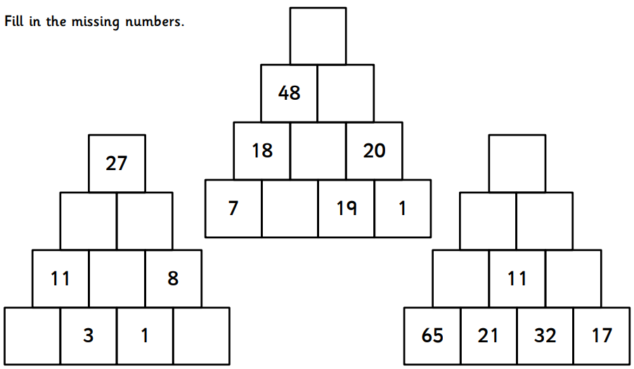
Pyramid puzzles…(be careful to work out the rule before you try and complete the boxes)
Easier
Tricky
Expert

Slide 13
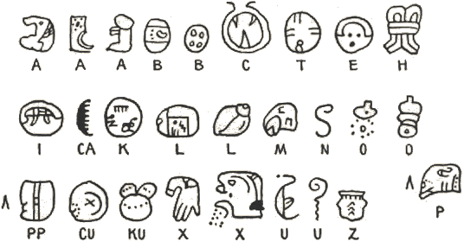
MAYAN ALPHABET (Note - the Mayans didn’t represent all the letters of our alphabet to you may have to create glyphs of your own to represent any missing letters you need to use!!

